Slide 1
Perception
NVIDIA AI Robot Club

Slide 2
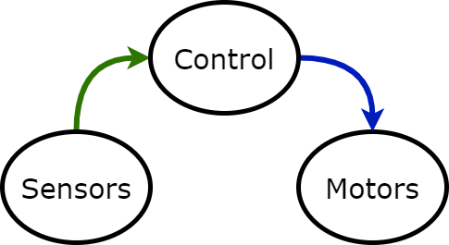
Basic Control
int
int

Slide 3
What do we want from sensors?
Position
Obstacles
Objects
Endpoints

Slide 4
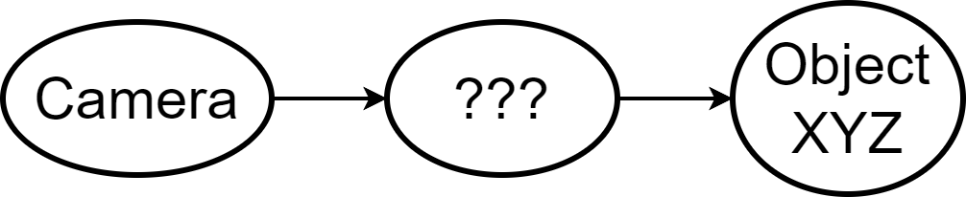
Object Detection

Slide 5
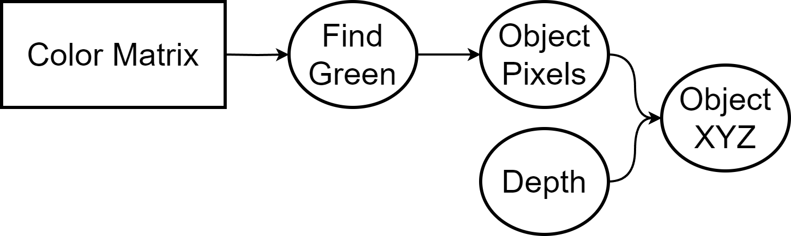
Basic Idea

Slide 6
Problems
“Green”?
Multiple green blobs
Lighting?
Edges/shapes?
Performance

Slide 7
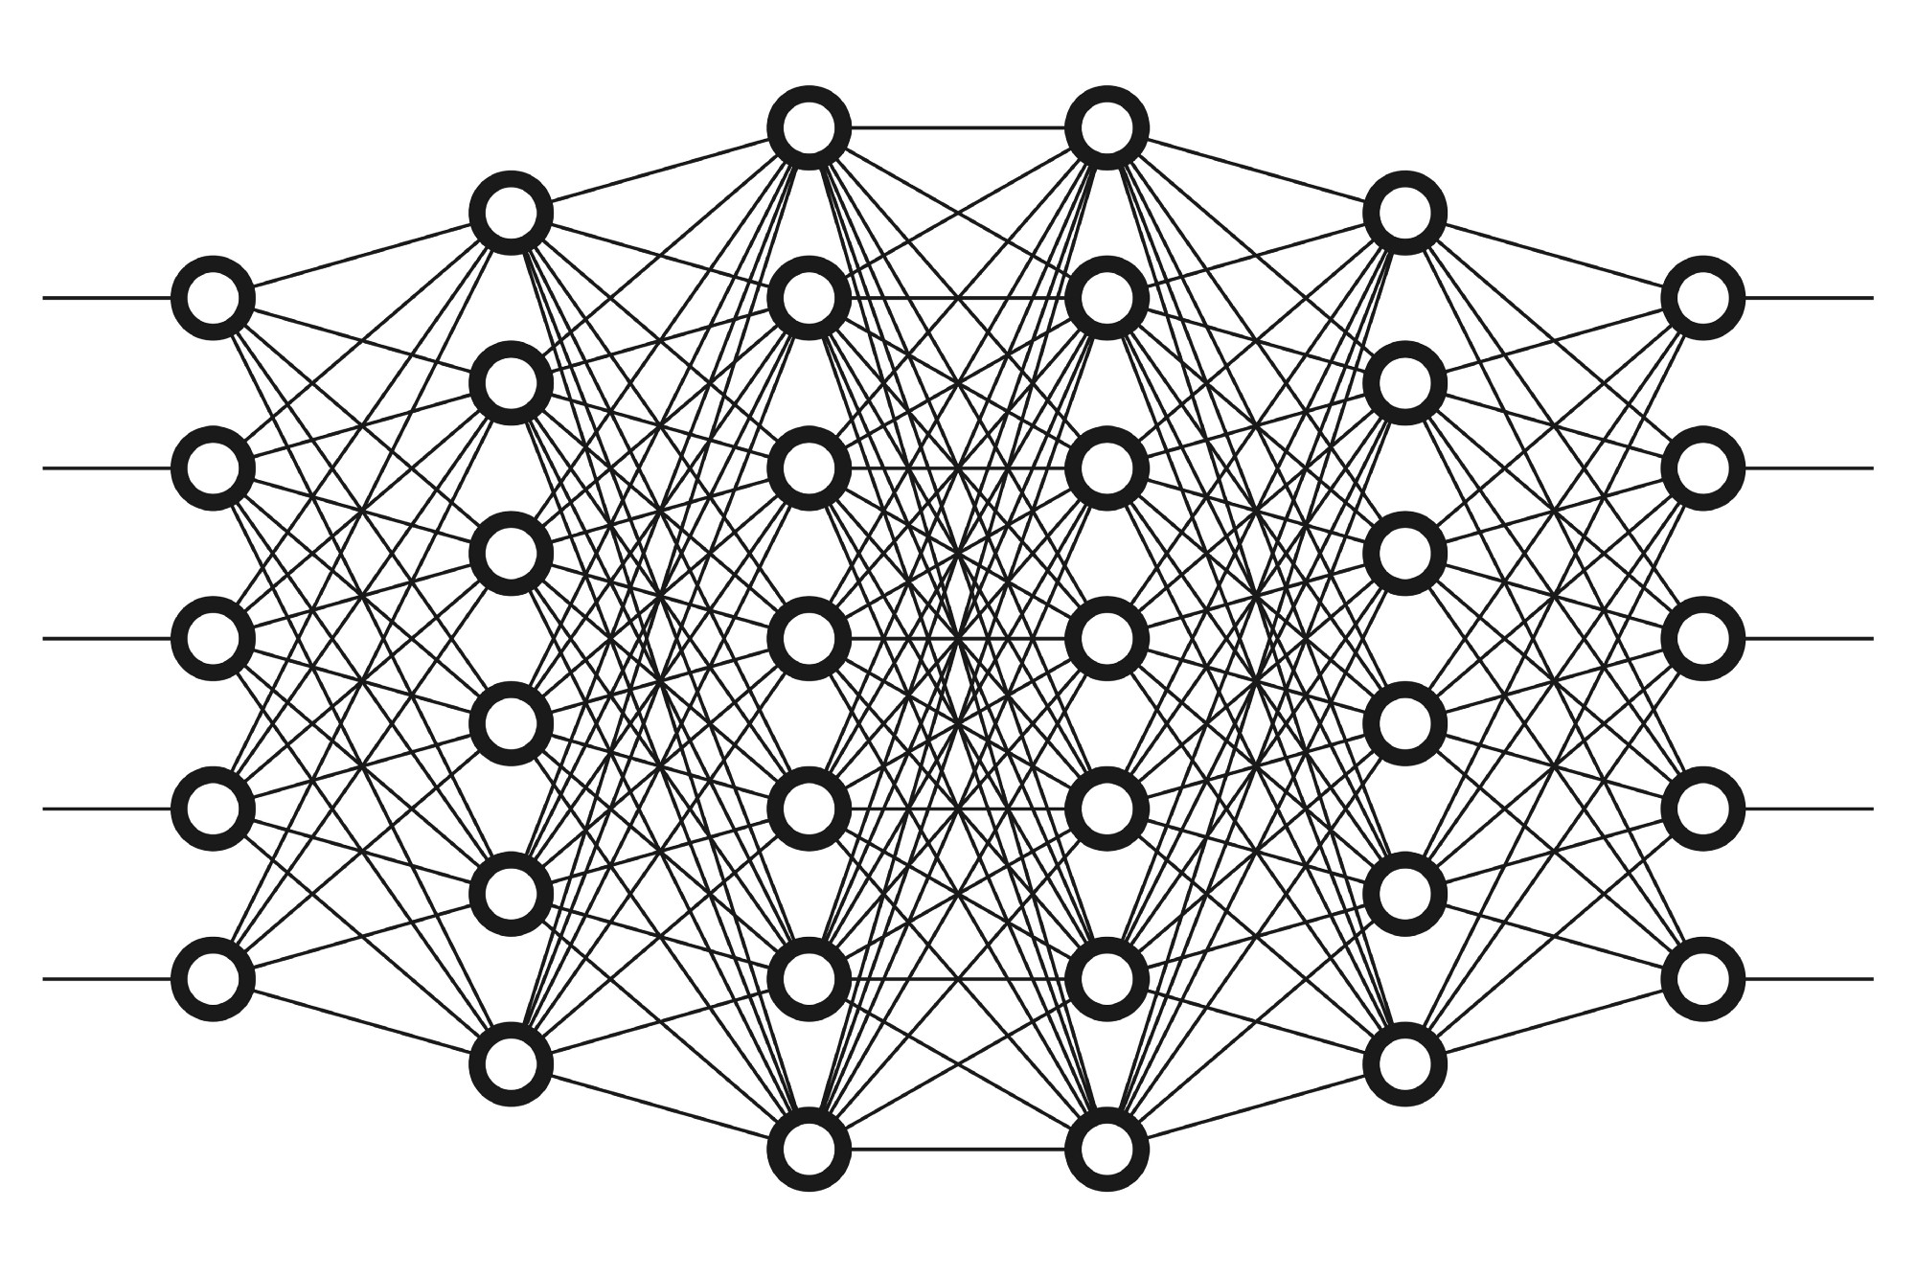
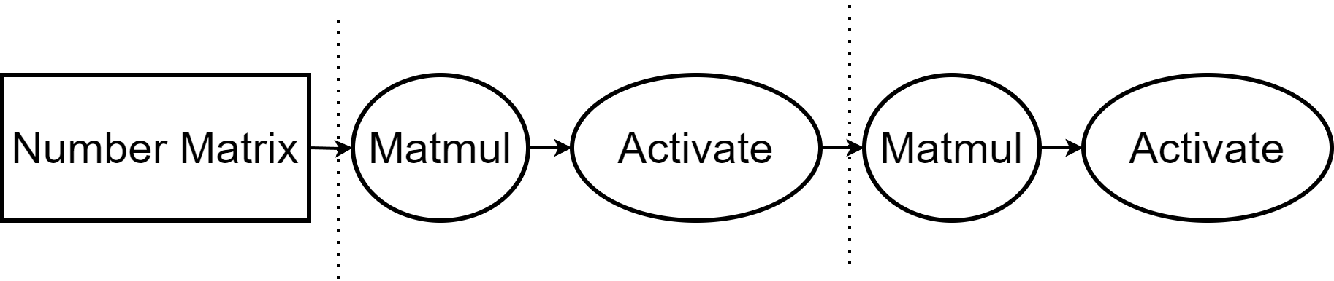
Neural network

Slide 8
Neural Network
Weights can learn a target
Learn “shapes” through convolution
Custom inputs → custom outputs
Super acceleration

Slide 9
Pretrained Object Detector
from torch.torchvision.models.detection import maskrcnn_resnet50_fpn
model = maskrcnn_resnet50_fpn(
pretrained=True, pretrained_backbone=True)
model.eval()
model.to('cuda')

Slide 10
Pretrained Object Detector
preprocess = transforms.Compose([ transforms.ToTensor(), ])
input_tensor = preprocess(Image.fromarray(color))
input_batch = input_tensor.unsqueeze(0).to('cuda')
with torch.no_grad():
output = model(input_batch)[0]
output = {l: output[l].to('cpu').numpy() for l in output}

Slide 11

Updated Pipeline

Slide 12
What Next?
Match Depth
Get center
Move/turn wheels until distance

